Slide 1
Educating young digital citizens
An opportunity and a challenge
Janice Richardson
6 November 2024

Slide 2
What is a digital citizenship?
A frame and a filter that guides the way we use technology and behave online. It helps us to:
connect and engage with others meaningfully, not only in the digital environment;
participate positively in online and offline activities, groups, communities;
learn continually throughout life to actively and positively contribute to shaping our world.
Connect & engage
Digital citizens shape the digital environment through their actions & behaviour
Participate positively
Become lifelong learners
Notes:
Digital citizenship is the frame that guides the way we use technology and behave online as we:
connect and engage with others meaningfully in the digital environment;
participate positively in online activities, groups, communities;
learn continually throughout life how to actively and positively contribute to shaping society.

Slide 3
How can we describe “digital citizens”?
Digital citizens are lifelong learners who:
are responsible, ethical users of digital technology, aware of its impact in all areas of their life
know how to protect the rights & information of themselves and others
cooperate meaningfully and positively on- and offline.
are open to other cultures, views and perspectives
build on the positives of the online environments, and understand how to overcome the negatives
As teachers, it is our role to use our knowledge and experience in the real world to guide children in the virtual world too, so that they learn to become ‘digital citizens’.
Notes:
Digital citizens ...
Know how to use digital technology sensibly, and how to behave ethically online.
Know how to protect their own rights and information, and are careful with those of everyone they communicate and interact with online.
Know how to cooperate meaningfully on- and offline, and contribute positively to the online activities that shape the digital environment.
Are open to other cultures and other people’s perspectives.
Build on the positives of the online environments they move in, and avoid the downsides.
Understand the importance of being lifelong learners, able to keep up with the rapid changes that digital technology is bringing to the world.

Slide 4
Why is digital citizenship education important?
Digital citizenship provides children with a set of competences that help them become:
more responsible about what they do online;
more resilient to the challenges of the virtual world;
more adaptable, open to different views, cultures, practices.
VALUES
Respect human rights, dignity, democracy
ATTITUDES
Interact respectfully &
meaningfully with others
SKILLS
Being a doer, as well as a thinker
KNOWLEDGE, CRITICAL UNDERSTANDING of self, the world, others
Notes:
Digital citizenship provides children with a set of competences and benchmarks that will guide their behaviour and actions both online and offline, helping them become:
more selective about who they meet and more responsible about what they do online;
more resilient to harm from things they see and hear online;
more adaptable to new situations, and open to other views, cultures, practices.

Slide 5
20 competences for a Democratic Culture.
= early childhood
= middle childhood
Values
Attitudes
Valuing democracy, justice, fairness, equality & the rule of law
Valuing cultural
diversity
Valuing human dignity
& human rights
Civil mindedness
Openness to cultural otherness, beliefs, world views & practice
Tolerance of ambiguity
Self efficacy
Respect
Responsibility
Listening & observing
Empathy Cooperation
Flexibility & adaptability
Linguistics, communication,
Autonomous learning
Analytical & critical thinking skills
Conflict resolution
Knowledge & critical
understanding of self
Critical understanding
of language & communication
Understanding world, politics, human
rights, culture, cultures, religions, economies, environment
Skills
Knowledge & critical understanding

Slide 6
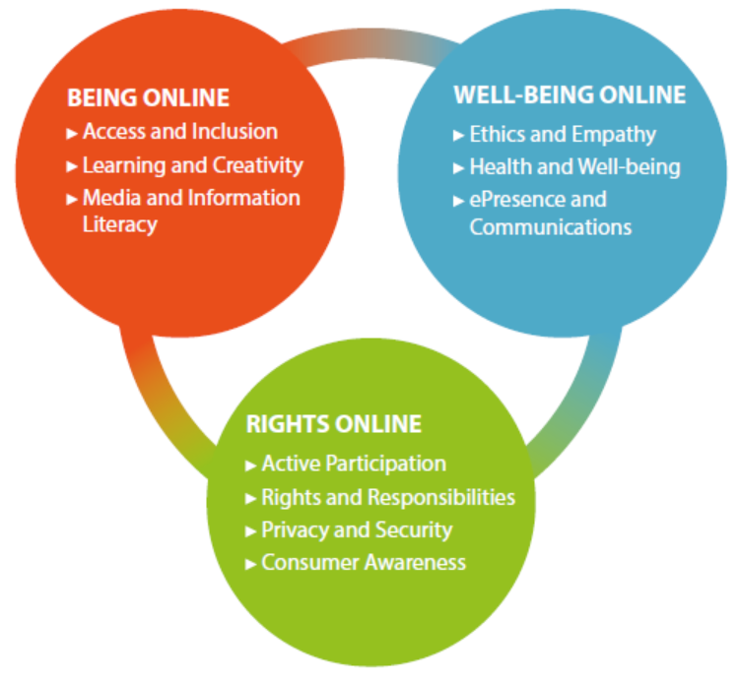
Different competences for different activities online
Digital Activity
Digital Acitivity
Digital activity
Understand digital tools & practices, become media savvy.
Guide children on their learning path, with an eye open to the pitfalls.
Being Online
Well-being Online
Use technology wisely, responsibly and creatively.
Develop self-esteem and an ethical compass, balance online-offline activities.
Rights Online
Understand rights, respect responsibilities
Protect privacy, themselves, their tools, the environment.
Notes:
Children participate in many different types of digital activities. In order to be as comprehensive as possible, the Council of Europe has subdivided these into 10 different areas (domains), that are broadly grouped into three clusters: Being Online, Well-being Online, Rights Online.
In this way, it supports parents and teachers as they strive to:
understand the things children need to learn step by step,
support their children as they venture into different domains,
find fun ways to guide their children on their path of learning, with an eye open for “trouble spots” that may arise,
have an overview of the benefits and risks children may encounter in each domain,
understand and make more sense out of the very complex and fast-moving digital world we live in.

Slide 7
The 10 domains at a glance
Being Online
Well-being Online
Rights Online
Access and inclusion – be an effective digital user, promote equal access to online & offline.
Learning and creativity – use digital tools creatively, become a lifelong learner.
Ethics and empathy – learn to be fair, ethical, open to diversity; develop empathy.
Media and information literacy – critically understand, interpret and use digital technology.
Health and well-being – awareness of impact of digital technology on mind
and body.
ePresence and Communication – maintain a positive online image, engage responsibly with others.
Active participation – take an active, ethical role in on- and offline communities.
Rights and responsibilities – know, understand, defend our rights, respect our responsibilities.
Consumer awareness – know our rights as users, consumers, entrepreneurs, and be ecologically responsible.
Privacy and security – protect tools and data, be mindful of the impact of actions on safety of self and others.

Slide 8
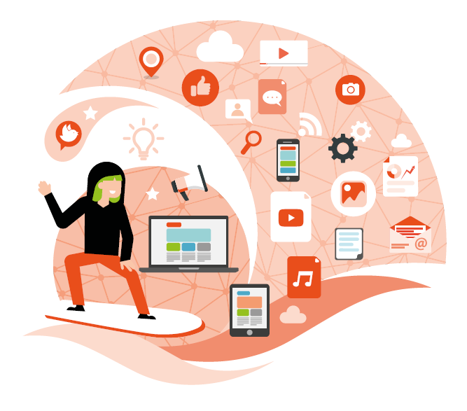
Media and Information Literacy
3.
How to tell if information sources are reliable
Compare sources, discern if news is fake
Use search engines effectively, compare results
Refine online searches for more targeted results
Understand how they are influenced by words, images, music used in advertising
Awareness of the dangers of stereotypes, and the impact of profiling, algorithms…
Fake news: is false or misleading information, (misinformation, disinformation, propaganda). Fake news is read by millions, and usually aims to trick users in some way, to disseminate information with harmful intent or to make money.
Notes:
Download or cut out a fake news item and get your children to draw up a list of all the ways you can see if something is probably fake. Explain that we are not all scientists or experts, and a lot of things found online are not always true.
Choose a topic and look it up using 2 or 3 different search engines and discuss with your children how different the results are.
Check the sources of the information together: are they from well-established organisations or renown scholars? Is the information up-to-date? Does it look like advertising?
Use (online) ads for children’s clothes or food your children like, and discuss how words, images, music etc. are used to influence us in the ad. Why do we prefer one particular brand against others?
Show your children how to refine their online search to get better results, for example, by placing precisely what you are looking for in quotes: “search phrase”. That will help you limit the results to your exact query.

Slide 9
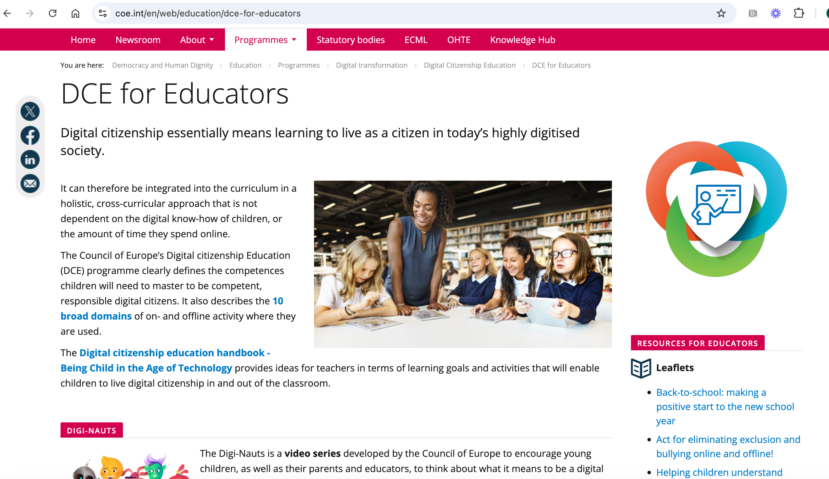
Digital Citizenship Education - Resources
https://www.coe.int/en/web/education/dce-for-educators

Slide 10
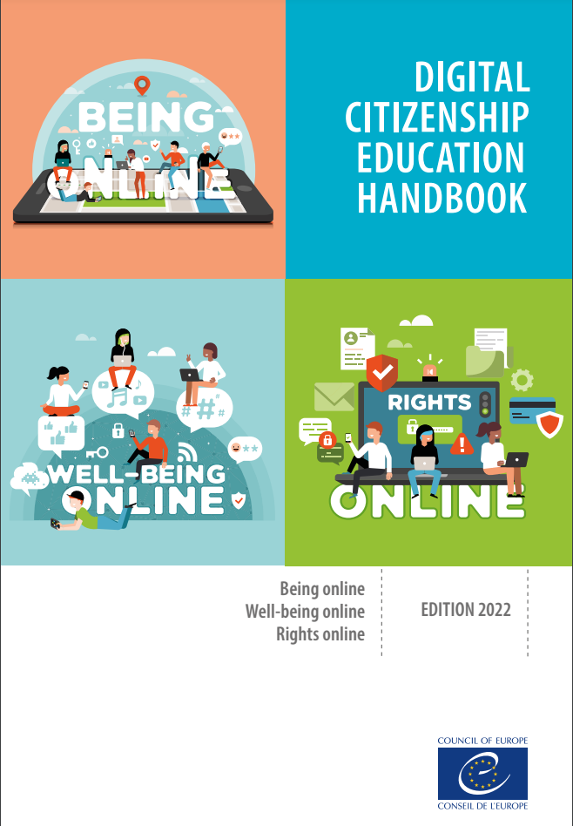
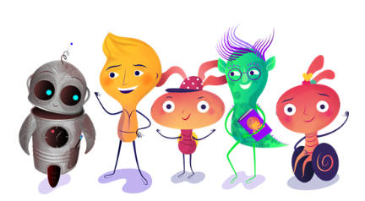
BOOKLETS
DCE Handbook
DCE Trainers’ Pack
Educating for a video game culture
Easy steps for teachers / parents
ONLINE COURSES
What is DCE ?
DCE & Cyberbullying
DCE & Disinformation
Access & Inclusion
Controversial issues online
DCE & Hate speech online
LEAFLETS FOR TEACHERS / PARENTS
Back to school
Eliminating bullying and exclusion
Understand rights & responsibilities
A New Year has begun – being active citizens
Protecting privacy, personal data
Holiday time – constructive activities for citizens
THE DIGI-NAUTS – children aged 4-9
3 videos (Inclusion, Well-being, Consumers
Children’s Activity Books
Teachers Guide

Slide 11
In conclusion, digital citizenship education aims to…
Help children learn to be respectful, responsible, ethical, empathetic, and open to the world
Foster trust, resilience and well-being online and offline
Boost creativity, improve skills, develop talents.
Empower children to become critical thinkers
Create a healthy balance between online and offline activities.
Develop awareness of how digital technology shapes our life & our future.
Show how to protect our rights and respect our responsibilities
Highlight the value of privacy & the importance of protecting personal data
Guide citizens to become ethical, responsible consumers.

Slide 12
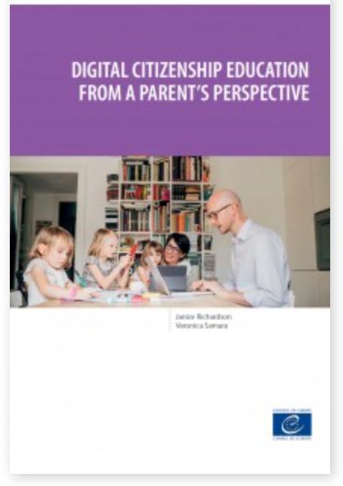
Only 1 in 3 parents say they understand digital citizenship
Less than 50% of parents say they know their children’s online friends
Less than 40% talk to their children about behaving respectfully & kindly online
75% of parents talk to their children about bullying
Almost 50% want DCE activities that they can do with their children at home
50%-70% OF PARENTS USE TECH WITH THEIR CHILDREN to watch videos, communicate with family, do homework.
1 in 10 create content with their children
1 in 5 show them how to use social networks

Slide 13
Thank you for your attention.
Learn more at
https://www.coe.int/en/web/education/dce-for-educators
https://www.insight2act.net
Janice.Richardson@insight2act.net

